Slide 1
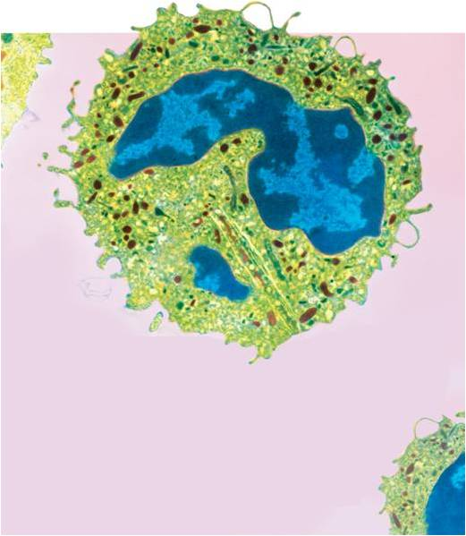
The Cell
The simplest unit of life

Slide 2
History of the cell
Seeing is believing = discovery of the cell came from advancements in technology.
Microscope (along with telescope)
1600’s Robert Hooke: Microscope maker; looked at many things under his microscope (40x) including living things.
When observing cork cambium from plants, described them as “prison cells”

Slide 3
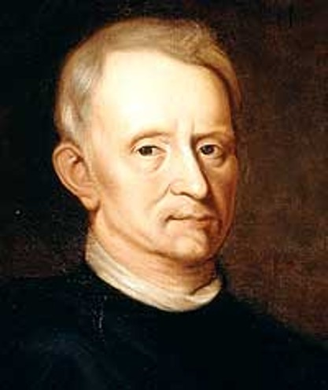
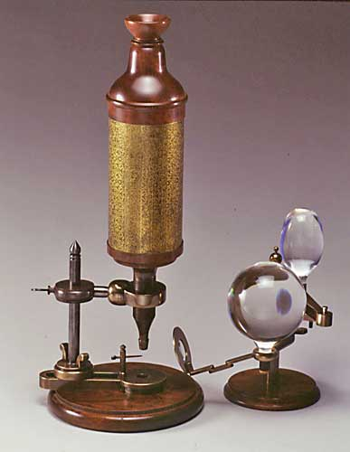

Slide 4
History of the cell
Also during the 1600’s Anton Van Leewenhoek produces sketches with magnifications up to 250x
Never get’s much credit b/c he did not share his technology; was found out after he died
By second science revolution (1800’s) microscopes were very powerful and many biologists used them to observe life.
These scientists used their discoveries to develop the cell theory.

Slide 5
The Cell Theory
Schleiden, Schwann, Virchow, Pasteur, etc.
All living things are composed of one or more cells.
Cells are the basic units of structure and function in living things
New cells are produced from existing cells, or all cells come from pre-existing cells.

Slide 6
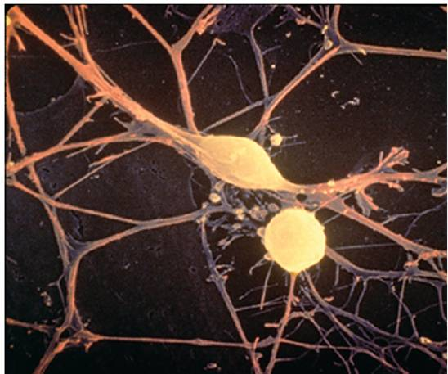
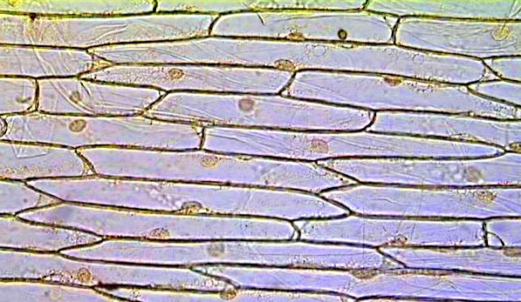
Confocal Light
Electron-scanning
Light

Slide 7
Types of cells
All cells can be categorized into one of two categories.
Prokaryotic & Eukaryotic
Venn diagram activity

Slide 8
Cell Structure
Organelles: Tiny membrane-bound structures found inside of cells, each with a particular function

Slide 9
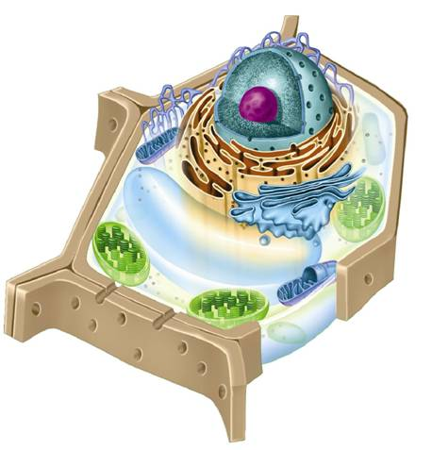
    Plant Cell
Nucleolus
Nucleus
Smooth endoplasmic reticulum
Nuclear envelope
Ribosome (free)
Rough endoplasmic reticulum
Ribosome (attached)
Cell wall
Golgi apparatus
Cell membrane
Chloroplast
Mitochondrion
Vacuole

Slide 10
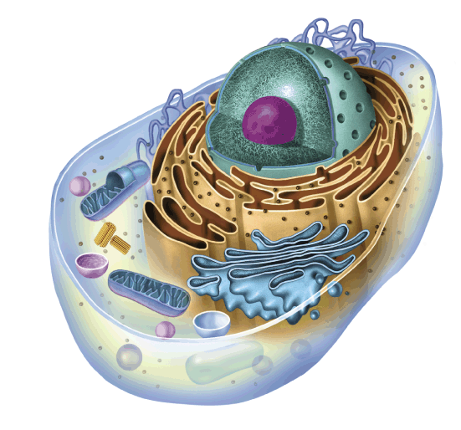
  Animal Cell
Smooth endoplasmic reticulum
Nucleolus
Nucleus
Ribosome (free)
Nuclear envelope
Cell membrane
Rough endoplasmic reticulum
Ribosome (attached)
Centrioles
Golgi apparatus
Mitochondrion

Slide 11
Cell Wall
Plant cells / prokaryotes
Made of cellulose (type of macromolecule?)
Support and rigidity

Slide 12
Plasma Membrane
All cells
Made of phospholipids (discussed later)
Controls what substances can enter and exit the cell

Slide 13
Cytoplasm
All cells
Mostly water (and other macromolecules)
Fluid that surrounds all organelles and is were most chemical reactions take place.

Slide 14
Nucleus
All Eukaryotic cells
Contains the DNA (fxn)
Has all information for making all proteins
Controls what proteins are made and when

Slide 15
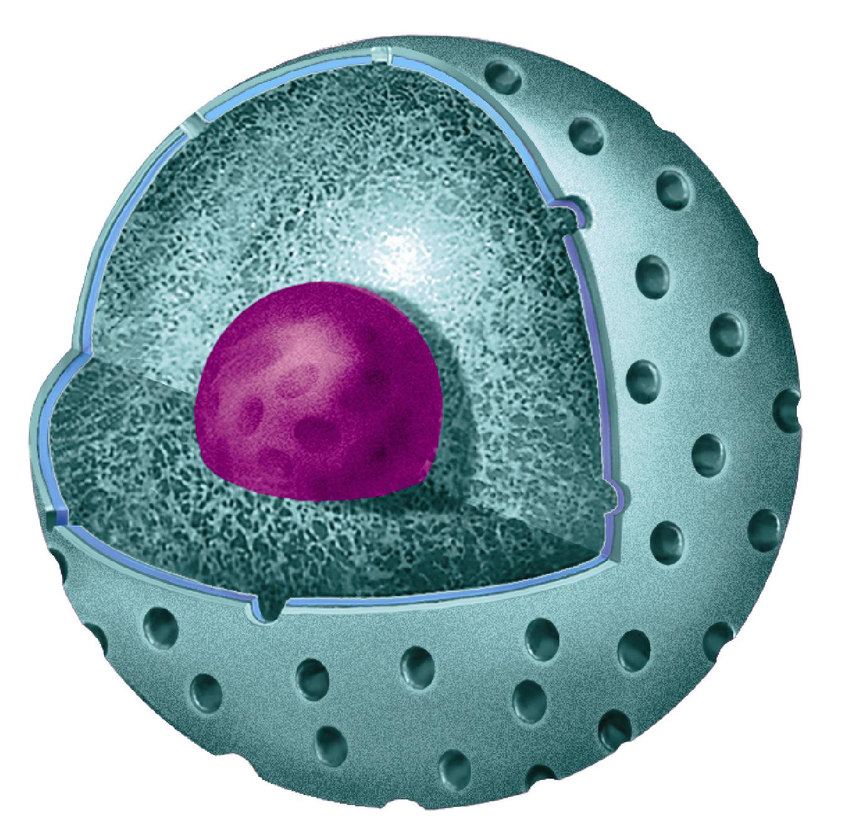
Nucleus
The Nucleus
Chromatin
Nucleolus
Nuclear envelope
Nuclear pores

Slide 16
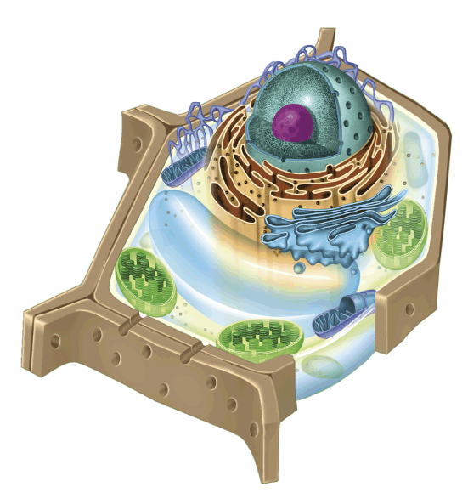
Chloroplast
Plant cells
Site of Photosynthesis
H₂O + CO₂ → C₆H₁₂O₆ + O₂
Sunlight drives this reaction; should all plant cells have them?
Chloroplast
Mitochondria

Slide 17
Mitochondria
All Euk. Cells
Site of Cellular Respiration
O₂ + C₆H₁₂O₆ → H₂O + CO₂
Transforms energy of sugar to useable energy for cell
Mitochondria

Slide 18
Ribosomes
All cells
Macromolecules (RNA); Very numerous inside of cells
Synthesize protein for the cell

Slide 19
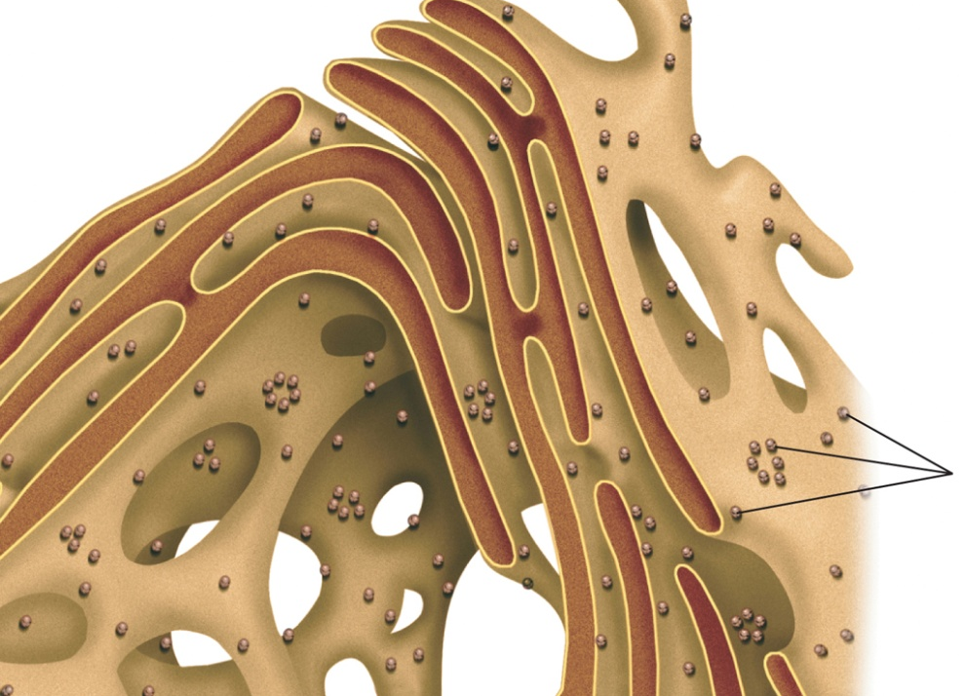
Endoplasmic Reticulum (smooth and Rough)
All Euk. Cells
Internal transport of macromolecules w/in cell separate from cytoplasm
If ribosomes are attached = rough
Ribosomes

Slide 20
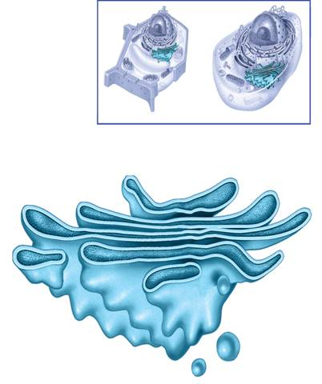
Golgi Apparatus
All Euk. Cells
Modifies proteins (and other macromolecules) from ER for transport out of cell.
(post office)

Slide 21
Lysosomes
All euk. Cells
Breakdown used macromolecules/materials inside of cells to be recycled
What reaction would take place inside?

Slide 22
Vacuole
All euk. Cells
Storage of substances (water, sugar, etc)
Vacuole

Slide 23
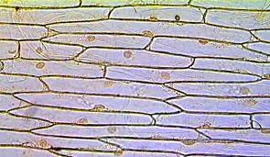
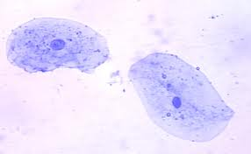
Onion Cell
Cheek Cell

