Slide 1
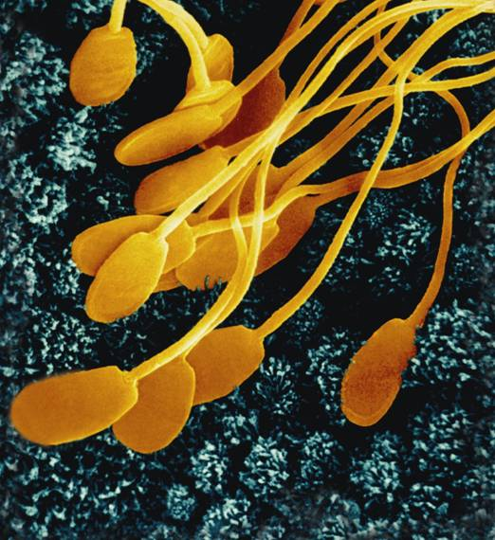
Reproductive System

Slide 2
Function
To pass on heritable traits (through DNA recombination) to further generations.
The formation of gametes (sperm or egg).
Delivery of sperm to egg for fertilization
Development of fetus
Birth of infant
Nourishment of infant post birth.

Slide 3
Male Reproductive System
Function = Production of sperm by meiosis and the effective delivery to female.

Slide 4
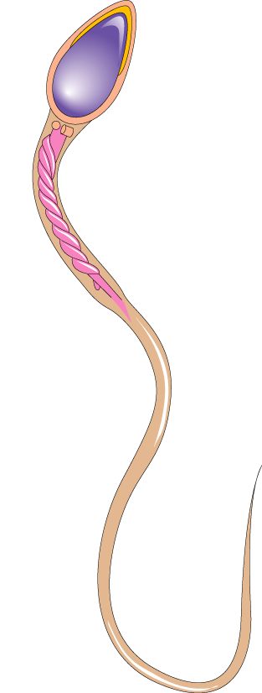
Where Sperm Forms
Head
Testis; housed w/in the scrotum = sac of dermal and muscular tissue that keeps testes @ ideal temp. for sperm development (9º F lower than body temp).
Upon puberty, males will produce 300,000,000 sperm cells a day (2.5 mill / drop of semen!)
Sperm cells can last for up to 48 hours inside female repro. syst.
Nucleus
Midpiece
Mitochondria
Tail

Slide 5
How sperm leaves testes
Sperm matures w/in many tubes inside of testes (74 days)
These tubes converge into one tube located on top of each testicle where sperm finish maturation = Epididymis.
Vas deferens = single duct that transports sperm from epididymis toward urethra.

Slide 6
Glands help prepare sperm for mission
A series of glands along vas deferens secrete fluids.
Seminal Vesicles (vesicular gland) = produce a fluid rich w/ fructose (molecule?)
Provide energy for sperm
Prostate Gland = produce a alkaline solution with a high pH.
Protection (by naturalizing) from the acidity of both the urethra and vagina

Slide 7
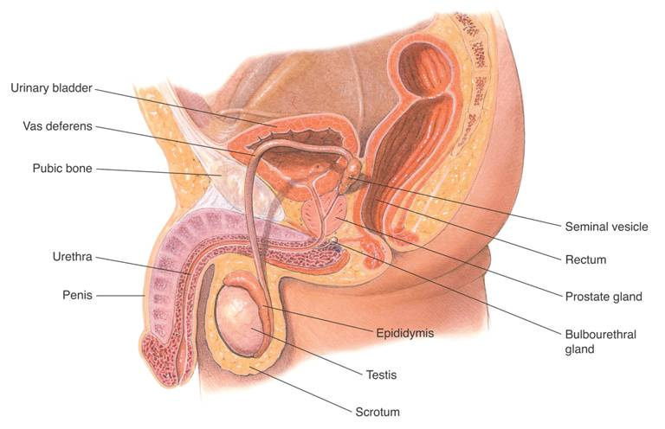
Male Reproductive System
Urinary bladder
Vas deferens
Pubic bone
Seminal vesicle
Urethra
Rectum
Penis
Prostate gland
Epididymis
Bulbourethral gland
Testis
Scrotum

Slide 8
Hormonal control of males.
At the onset of puberty, the hypothalamus stimulates the pituitary gland to secrete two hormones.
FSH = tells testicles to begin production of sperm cells.
LH = tells testicles to begin production of its hormone.
Testicular Hormone:
Testosterone = responsible for 2º sex characteristics
Increase of body hair, increase muscle mass, increase growth rate, deepening of voice.

Slide 9
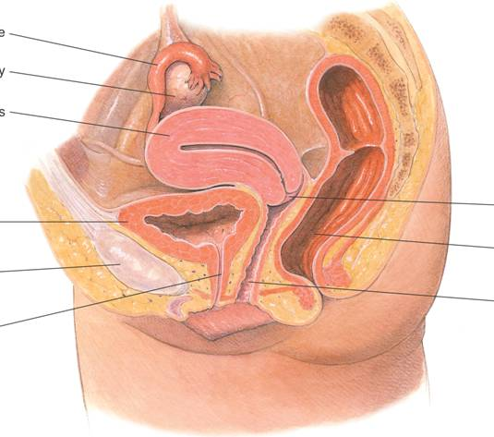
Female Reproductive System
Fallopian tube
Ovary
Uterus
Cervix
Urinary bladder
Rectum
Pubic bone
Vagina
Urethra

Slide 10
Female Reproductive System
Four main hormones: FSH, LH, Estrogen, and Progesterone. Know where made, and what they do.
Puberty in females:
Hypothalamus (in brain) stimulates pituitary gland to make FSH and LH which act on the ovaries.
Developing fetus ovaries have already begun meiosis and are in a resting stage (prophase I)
Females at birth have all eggs (1º oocytes) they will ever have, finish meiosis one at a time at the onset of puberty, when they run out = menopause.

Slide 11
The Menstrual Cycle
28 day cycle, begins at puberty, has 3 phases.
1) Flow phase: (days 1 - 5)
- Menstrual flow = shedding of the uterine lining when unfertilized egg does not implant.
- Rising levels of FSH cause development of new follicle (tissue surrounding undeveloped egg)

Slide 12
The Menstrual Cycle
2) Follicular phase: (days 6 – 14)
- When FSH declines and LH begins to rise, the ovaries respond by making estrogen. This tells uterus to begin repair of lining as well as 2º sex characteristics at puberty.
- Follicle continue to develop and mature
- At end (days 12 – 14), huge rise in LH causes ovulation = release of egg in oviducts

Slide 13
The Menstrual Cycle
3) Luteal Phase: (15 – 28)
- Ruptured follicle turns into a corpus luteum = produces hormone progesterone.
- Progesterone causes uterine lining to thicken, increase blood supply (with nutrients), and accumulates fat in preparation of a fertilized egg.
- As corpus luteum breaks down there will be a drop in progesterone causes menstrual flow.
- Birth control pills cause this to stay elevated.

Slide 14
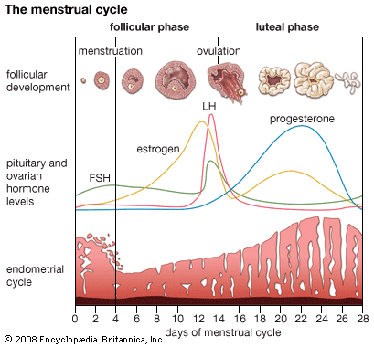
The Menstrual Cycle

Slide 15
Reproductive System Dissection
Female:
Ovary
Oviduct (fallopian tube)
Uterus
Male:
Testis
Epididymis
Prostate
Seminal Vesicles
Vas deferens
Scrotum

