Slide 1
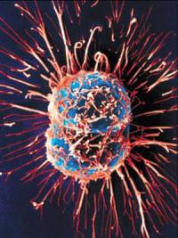
Cancer
A mistake in the cell cycle that results in uncontrolled cell division.

Slide 2
What controls the cell cycle?
Genes: segments of DNA that controls the production of proteins.
Enzymes = types of proteins
2 different enzymes control the cell cycle. (One tells cell to go on past G₁, the other tells the cell to stop and stay in G₁.)

Slide 3
Causes of cancer
There is a mutation (mistake) in the DNA.
When in the cell cycle would this happen?
These mistakes cause either an overproduction or an underproduction of those two enzymes.
How?
Too much “go” or not enough “stop”

Slide 4
Causes of cancer cont’d
What causes the DNA to mutate resulting in cancer?
Inheritance (family history)
Environmental factors:
UV rays
Nicotine
Air and Water Pollution
Viruses (cervical cancer)

Slide 5
Why is cancer dangerous?
Most cells that transform into cancer cells are destroyed by immune system. When they go undetected they form tumors
Tumor = a mass of cancerous cells dividing uncontrollably.
How can that kill you?
Those cells spend too much time dividing, not enough in G₁ (not doing job)
Division is costly (energetically); cancer cells deprive normal cells of nutrients, meaning they can’t do their jobs adequately.

Slide 6
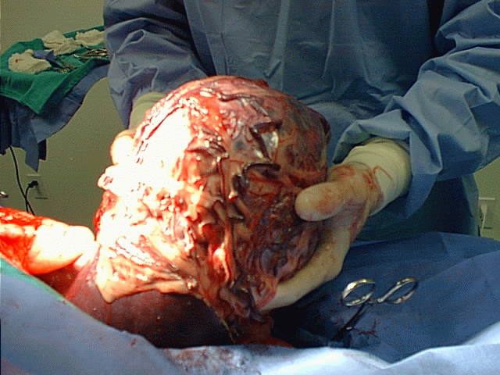
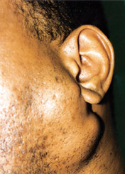
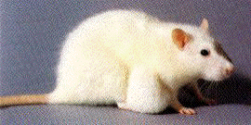

Slide 7
Types of tumors
Metastasis: When the body responds to tissues that need more energy it forms more blood vessels. When this happens to a tumor, it causes the spread of cancer cells to locations distant from their original site.
Benign Tumors: Have not metastasized.
Malignant Tumors: Have metastasized.

Slide 8
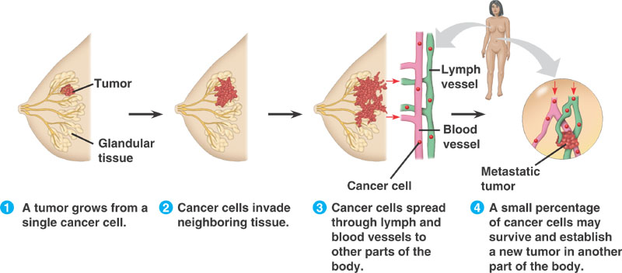

Slide 9
Treatments
Prevention: Gene Sequencing, early detection
Removal of tumor
Chemotherapy & Radiation
Hormone Therapy
Vaccines (preventative)
Immunotherapy
No cure yet. Only successful and unsuccessful treatments

